Slide 1
Energy Demand Allocation
Ferran Torrent
Beatriz López
Dídac Busquets
Jeremy Pitt

Slide 2
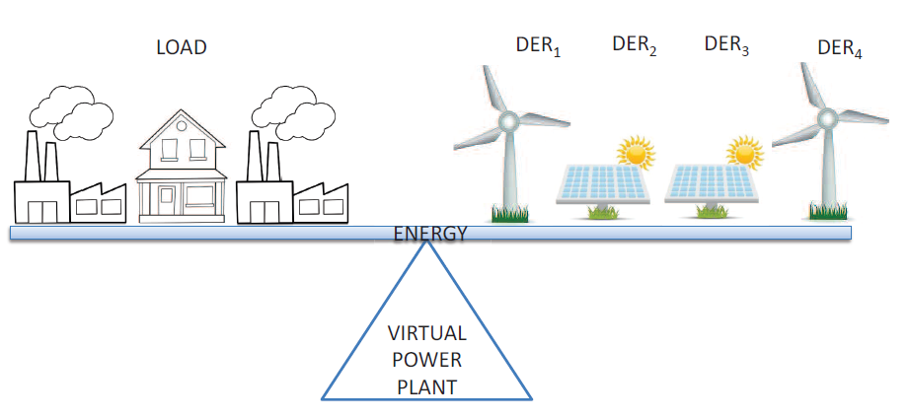
Motivation
Increase of Distributed Energy Resources (DERs)
Complexity for integrating DG into the labyrinthine distribution system
Aggregate and locally control DERs: VPPs, microgrids
  Need of local management methods

Slide 3
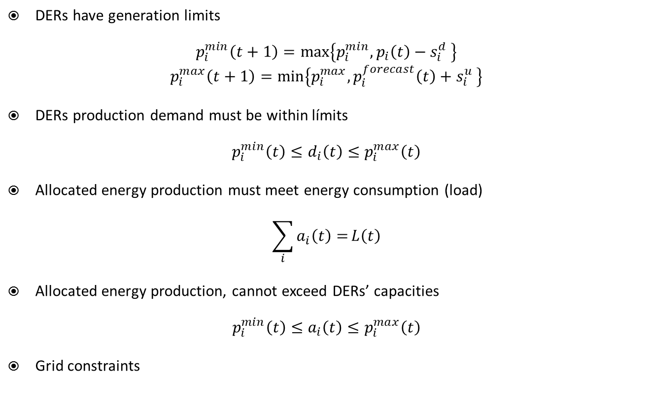
Constraints
DERs have generation limits
$$p_{i}^{min}\left(t+1\right)=max\left\{p_{i}^{min},p_{i}\left(t\right)−s_{i}^{d} \right\}$$
$$p_{i}^{max}\left(t+1\right)=min\left\{p_{i}^{max}, p_{i}^{forecast}\left(t\right)+s_{i}^{u} \right\}$$
DERs production demand must be within límits
$$p_{i}^{min}\left(t\right)≤d_{i}\left(t\right)≤p_{i}^{max}\left(t\right)$$
Allocated energy production must meet energy consumption (load)
$$\sum_{i}{a_{i}\left(t\right)=}L\left(t\right)$$
Allocated energy production, cannot exceed DERs’ capacities
$${p_{i}^{min}\left(t\right)≤a}_{i}\left(t\right)≤p_{i}^{max}\left(t\right)$$
Grid constraints

Slide 4
Energy demand allocation
Determine the amount of energy each DER has to produce in a VPP or microgrid
Micro-grid management
Centralised management
Decentralised management
Literature
DERs owned by the same organisation
Multi-agent
(i.e. auctions)
Self-organisation

Slide 5
Self-organisation & Distributive justice
Self-organisation (Ostrom’s principles):
  Clearly defined boundaries
  Congruence between appropriation and provision rules
  Effective monitoring
  Graduated sanctions
  Fast & cheap conflict-resolution mechanisms
  Absence of external interferences
  Nested institutions
Distributive justice (Rescher’s canons):
    Canon of equity: allocations, rounds with allocation and payments
    Canon of needs: satisfaction
    Canon of productivity: production success rate
    Canon of effort: active time as member
    Canon of social utility: CO₂ emissions
    Canon of supply & demand: capacity of generation when others cannot
    Canon of ability
Canons
Implemented functions
Implementation through voting functions
Abstract game [Pitt et al., 2012]

Slide 6
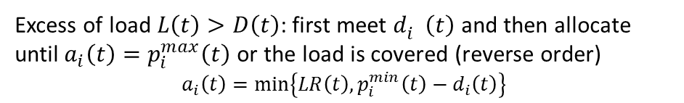
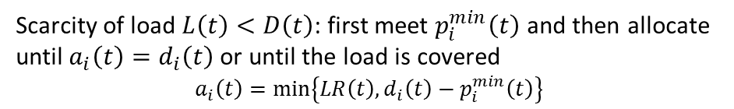

Methodology
$$P^{min}(t)≤L(t)≤P^{max}(t)$$
Canons rank DERs
(using functions weights)
Distributive justice
(Ranking done using functions weights)
Scarcity of load $L\left(t\right)<D\left(t\right)$: first meet $p_{i}^{min}\left(t\right)$ and then allocate until $a_{i}\left(t\right)=d_{i}\left(t\right)$ or until the load is covered
$$a_{i}\left(t\right)=min\left\{LR\left(t\right),d_{i}\left(t\right)−p_{i}^{min}\left(t\right)\right\}$$
Allocation through ranking
$L\left(t\right)=D\left(t\right)$: $a_{i}\left(t\right)=d_{i}\left(t\right)$ for all DERs
Excess of load $L\left(t\right)>D\left(t\right)$: first meet $d_{i}^{}\left(t\right)$ and then allocate until $a_{i}\left(t\right)=p_{i}^{max}\left(t\right)$ or the load is covered (reverse order)
$$a_{i}\left(t\right)=min\left\{LR\left(t\right),p_{i}^{min}\left(t\right)−d_{i}\left(t\right)\right\}$$
DERs vote canons
(update of the weights)
Self-organisation

Slide 7
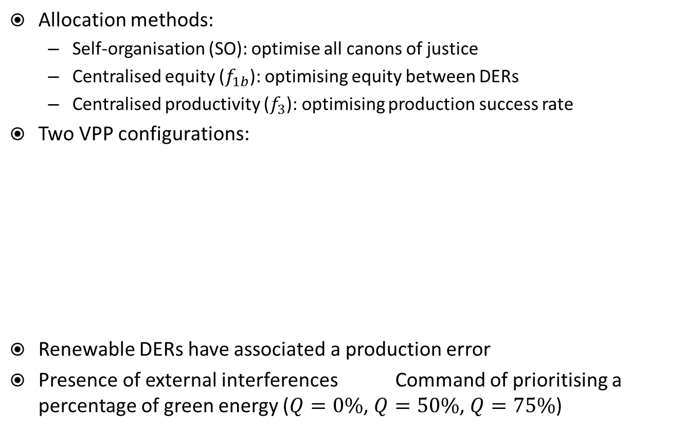
Experimentation
Allocation methods:
  Self-organisation (SO): optimise all canons of justice
  Centralised equity ($f_{1b}$): optimising equity between DERs
  Centralised productivity ($f_{3}$): optimising production success rate
Two VPP configurations:
Renewable DERs have associated a production error
Presence of external interferences Command of prioritising a percentage of green energy ($Q=0\%$, $Q=50\%$, $Q=75\%$)
 | Case 1 | Case 2
Combined heat & power | 2 of 2MW | 1 of 20MW
Photovoltaic | 2 of 2MW | 4 of 2MW
Wind turbine | 2 of 2MW | 2 of 2MW
Battery | 2 of 2MW | 4 of 2MW

Slide 8
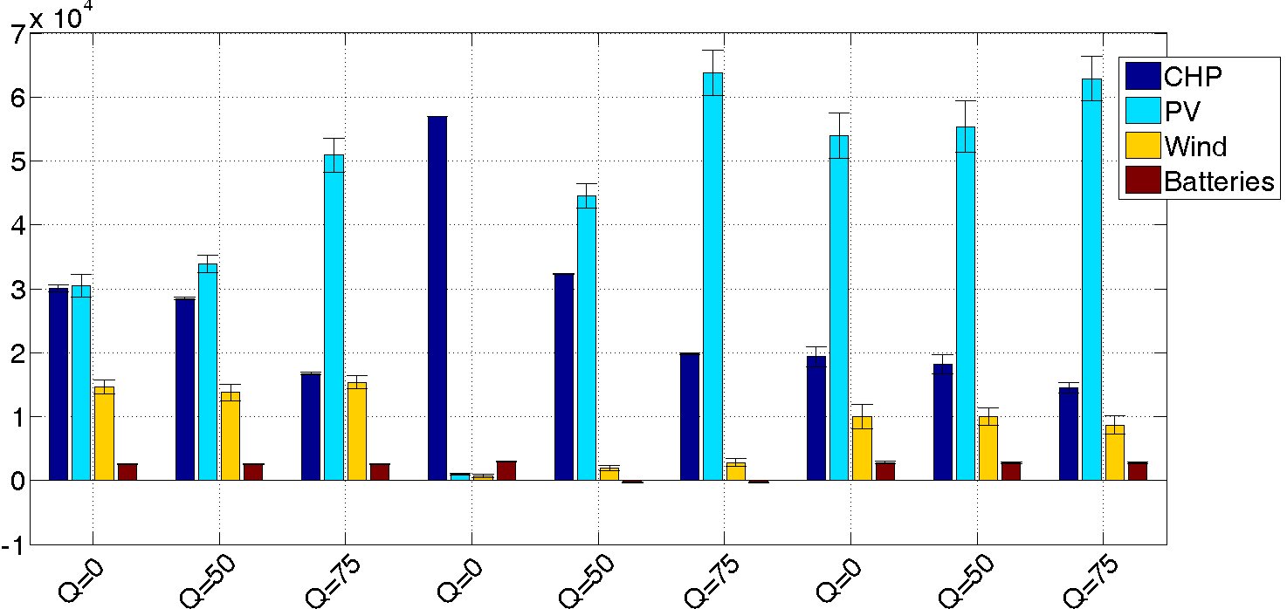
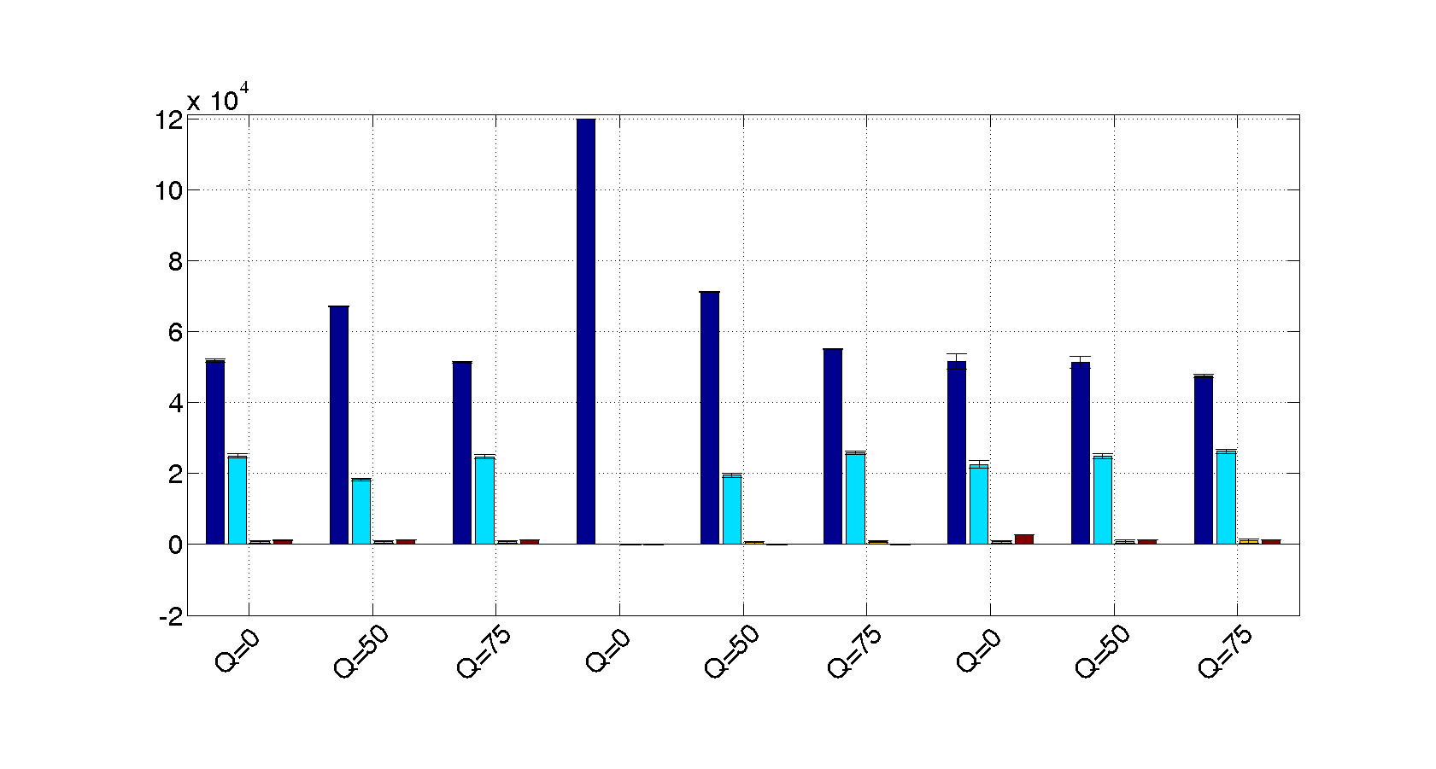
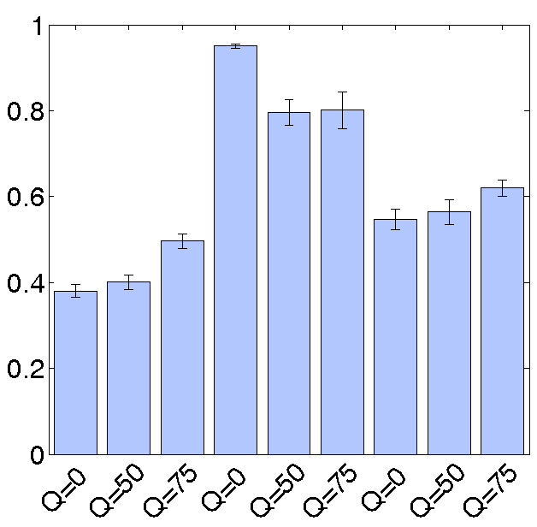
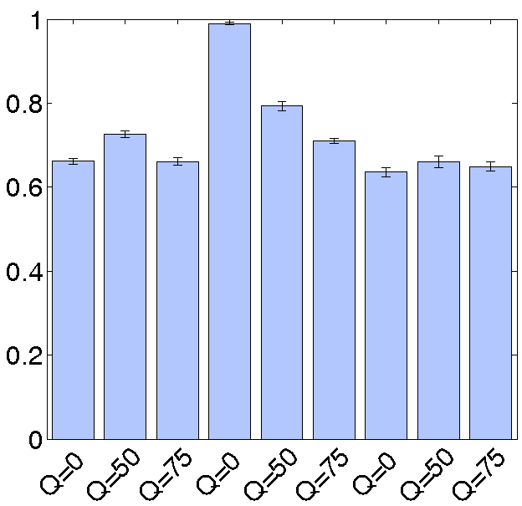
DERs benefits
Case 1 (equal size generators)
Case 2 (one big generator)
equity
productivity
SO
equity
productivity
SO
Utility
equity
productivity
SO
equity
productivity
SO
Gini index
Gini index

Slide 9
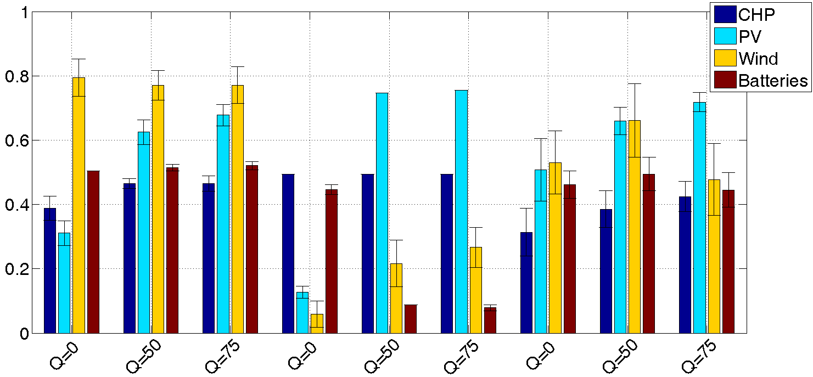
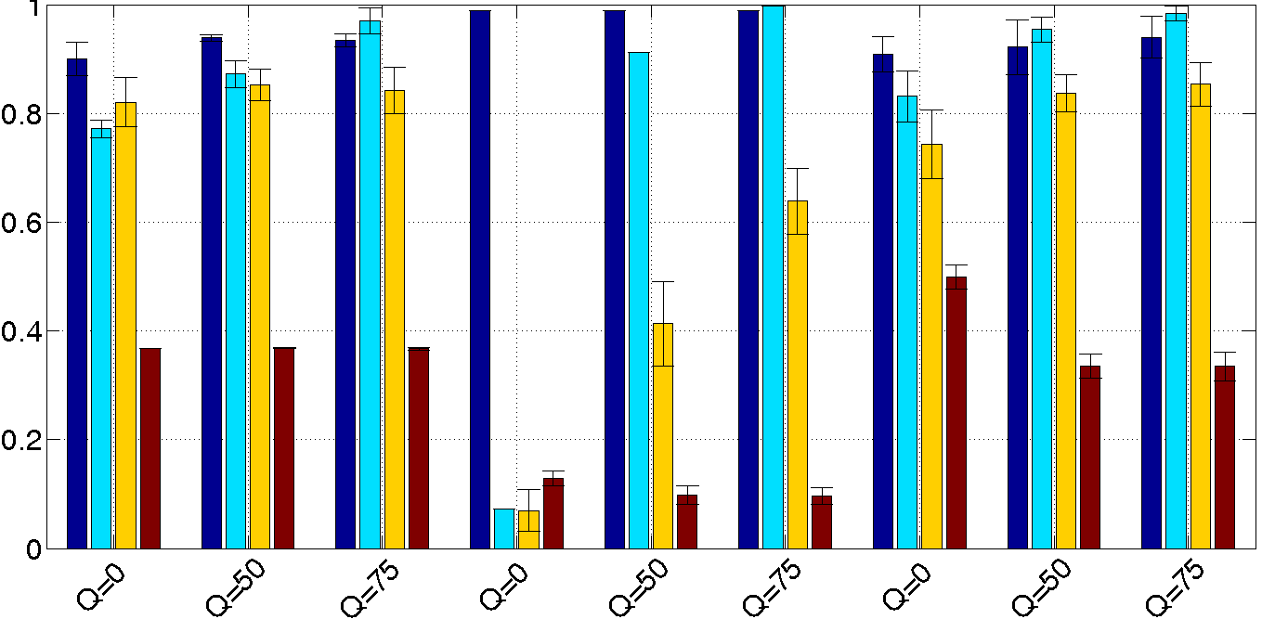
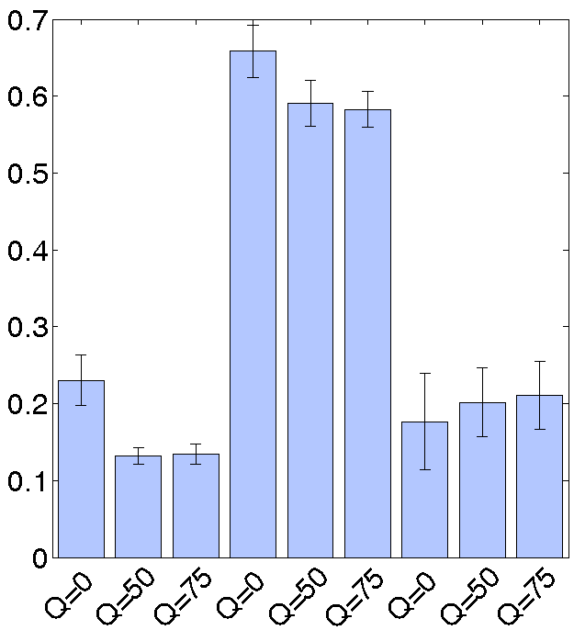
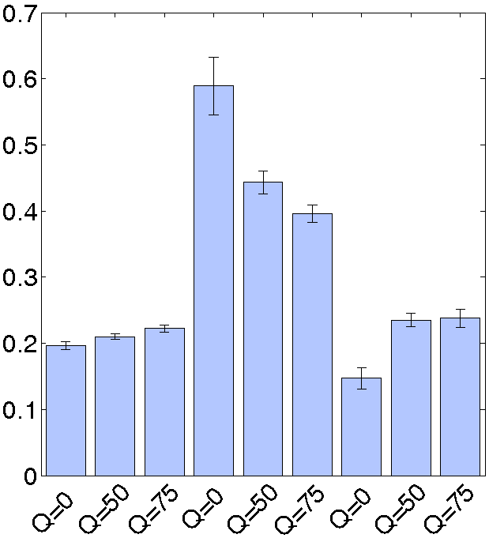
DERs satisfaction
Case 1 (equal size generators)
Case 2 (one big generator)
equity
productivity
SO
equity
productivity
SO
equity
productivity
SO
equity
productivity
SO
Gini index
Gini index

Slide 10
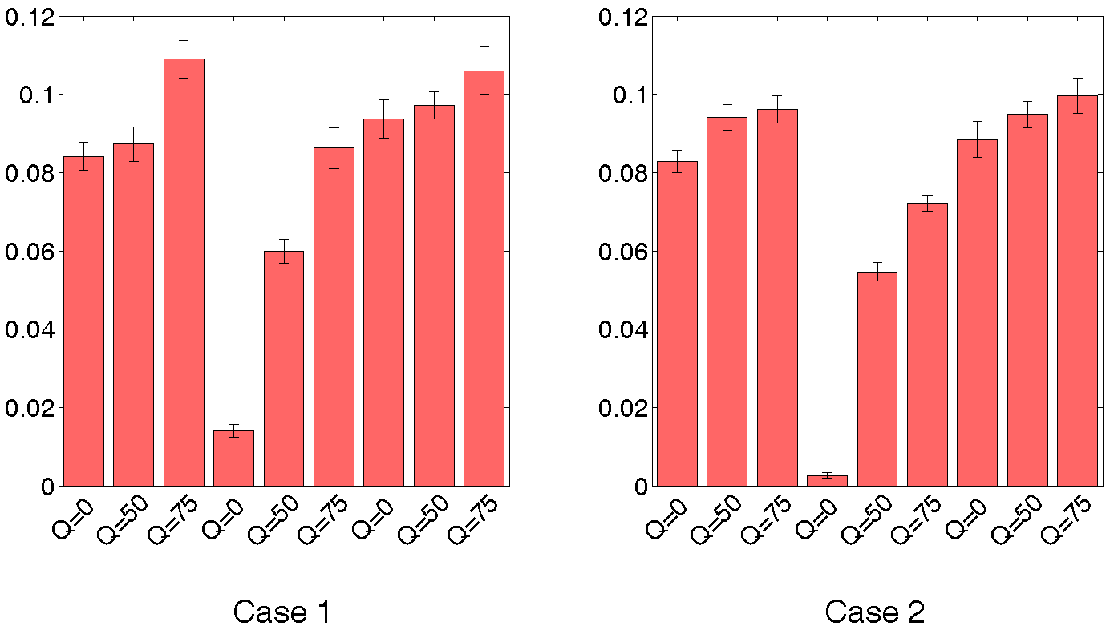
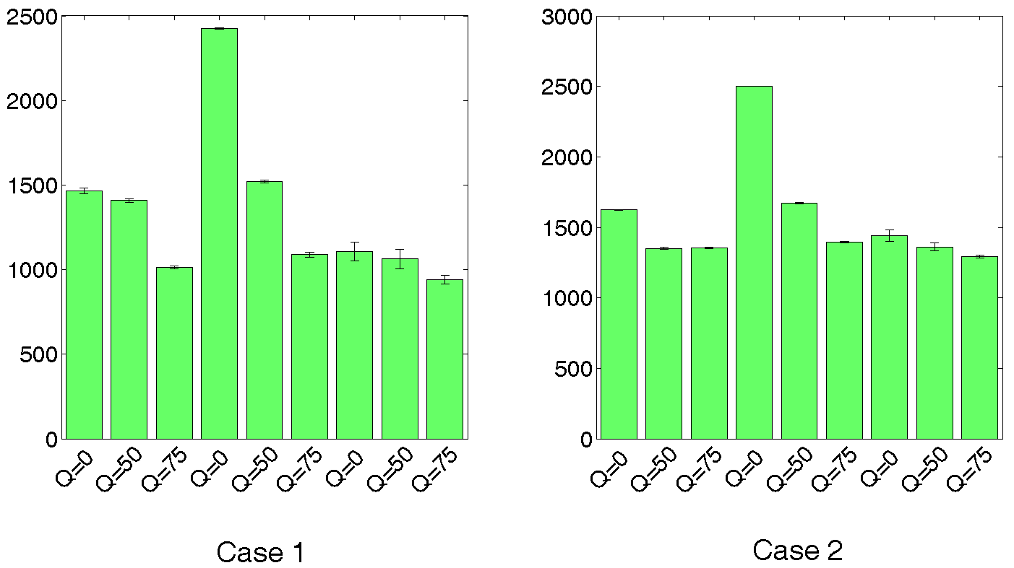
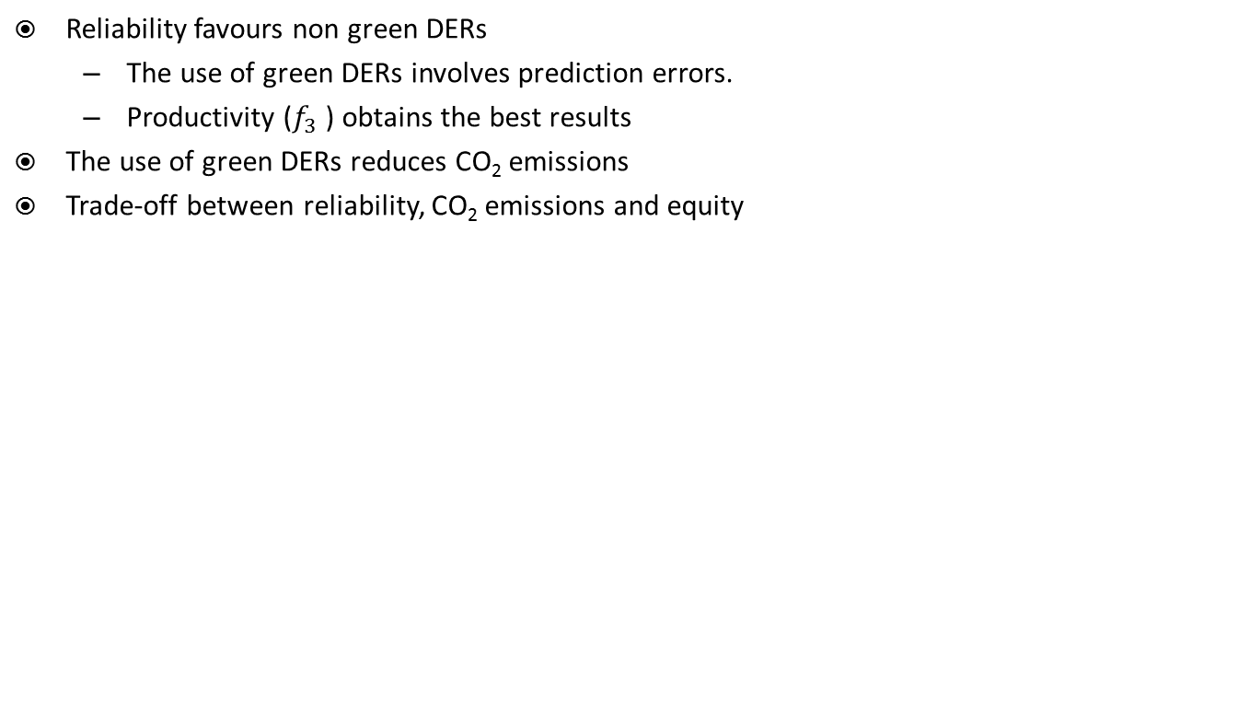
Reliability and CO₂ emissions
Reliability favours non green DERs
  The use of green DERs involves prediction errors.
  Productivity ($f_{3}$ ) obtains the best results
The use of green DERs reduces CO₂ emissions
Trade-off between reliability, CO₂ emissions and equity
Uncovered demand
Carbon emissions
equity
productivity
SO
equity
productivity
SO
equity
productivity
SO
equity
productivity
SO

Slide 11
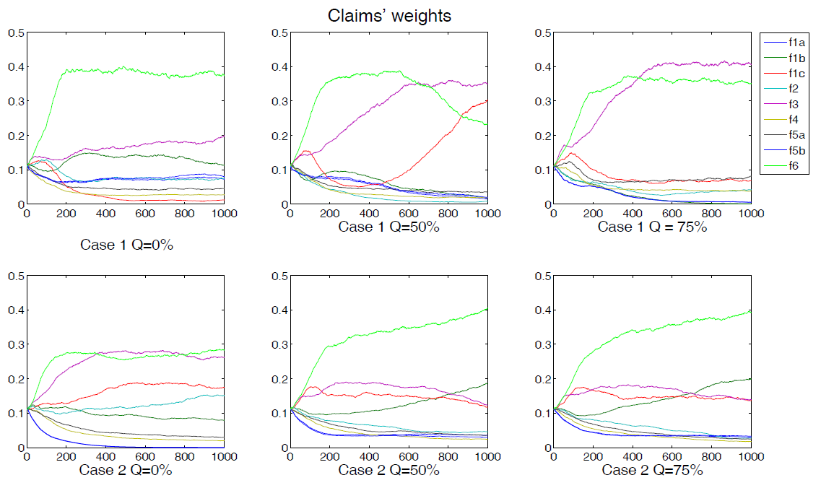
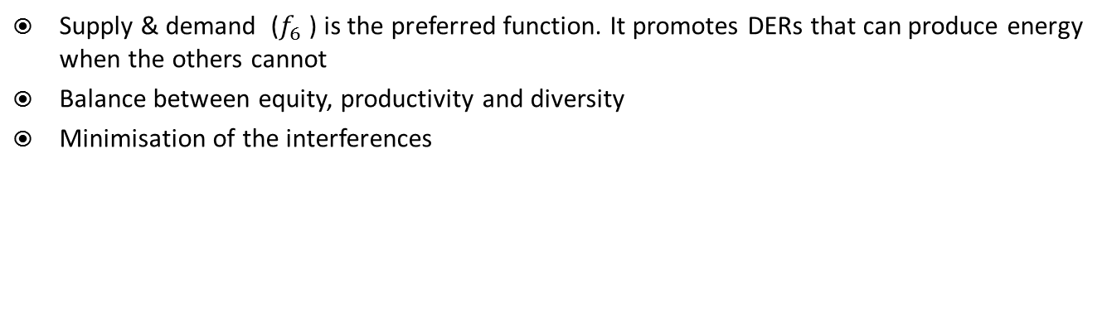
Evolution of canons weights
Supply & demand ($f_{6}$) is the preferred function. It promotes DERs that can produce energy when the others cannot
Balance between equity, productivity and diversity
Minimisation of the interferences
Functions weights
Adaptable to new situations
Robust against interferences

Slide 12
Publications
F. Torrent-Fontbona, B. López, D. Busquets, J. Pitt. Self-organising energy demand allocation through canons of distributive justice in a microgrid. Engineering Applications of Artificial Intelligence, 52:108-118, 2016.
F. Torrent-Fontbona. Optimisation methods meet the smart grid. New methods for solving location and allocation problems under the smart grid paradigm. PhD Thesis, University of Girona, 2015.
Pitt, J., Schaumeier, J., Busquets, D., Macbeth, S., 2012. Self-organising common-pool resource allocation and canons of distributive justice. In: 2012 IEEE Sixth International Conference on Self-Adaptive and Self-Organizing Systems, pp. 119–128

Slide 13
Thank you for your attention

